Slide 1


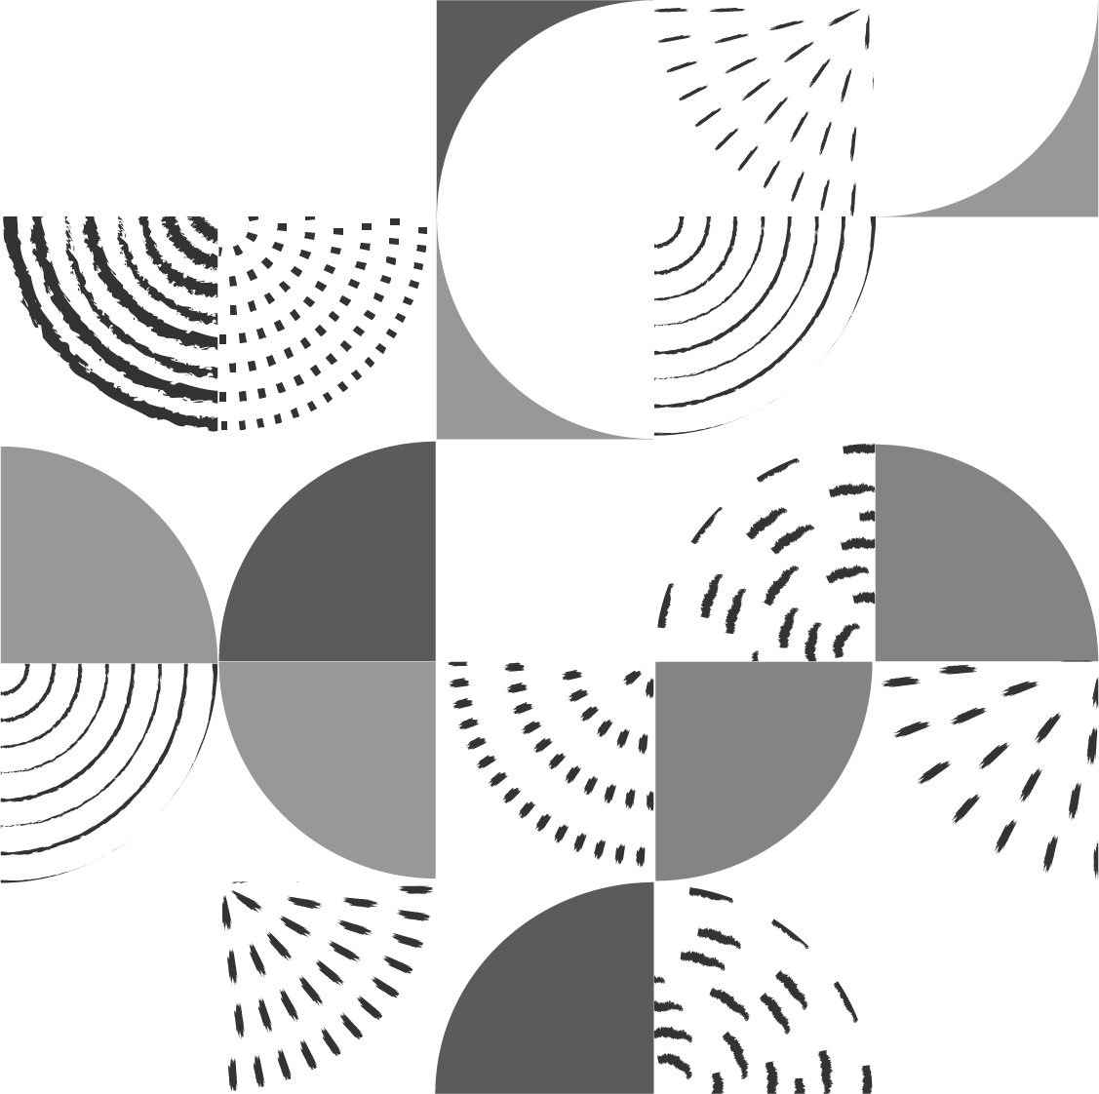
Optimization of Bistable Silicon Photonic MEMS Switch Architectures
Midterm presentation
Responsible : Prof. Niels Quack Supervisor : Dr. Hernán Furci Author : Claudio Jaramillo
1

Slide 2
Table of contents
Introduction & scope of the project
Original design & optimization
Design 1 : Linear Coupler
Design 2 : U-Turn Coupler
Other design ideas
Conclusions and future prospects
2

Slide 3

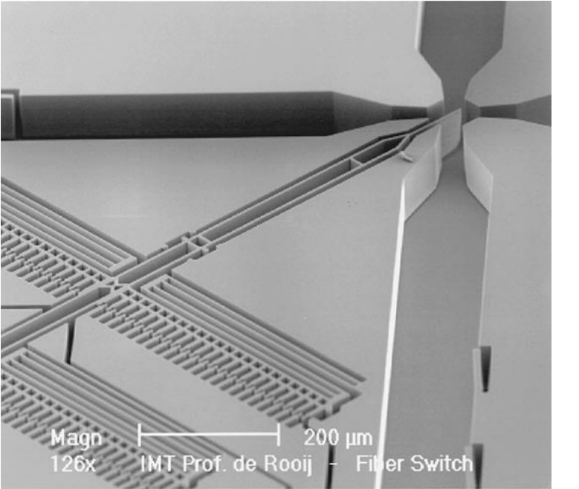
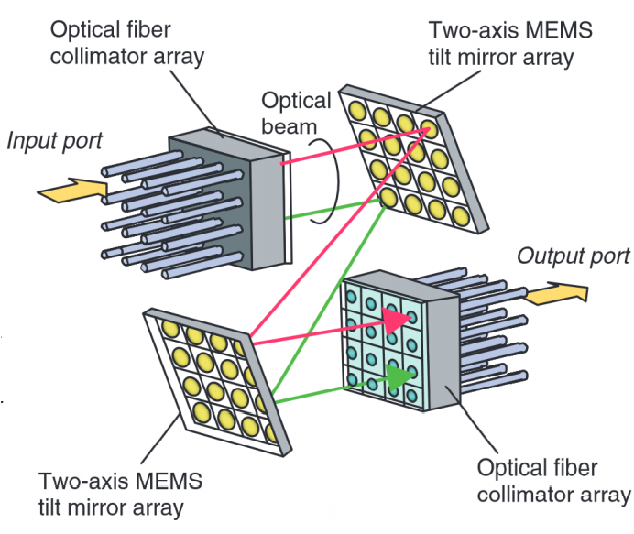
1.1 Introduction – Optical switches
Optical switch : device that switches optical signals between channels.
Historically using mirrors.
MEMS are advantageous for their integration capabilities, reliability, and low power consumption.
Silicon photonic MEMS allows us to use well understood fabrication procedures.
Exploiting mechanical properties of MEMS, instability under buckling creates 2 stable states : we have created a latching switch.
3

Slide 4
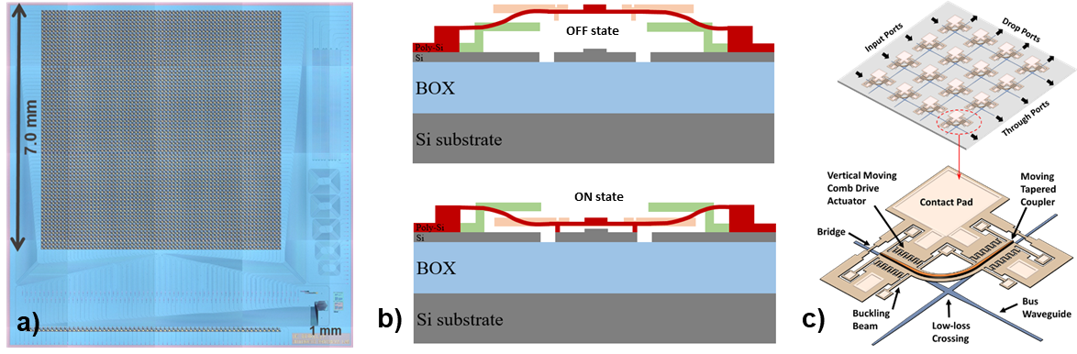
1.2 Scope of the project
“Silicon Photonic MEMS Switches have recently been shown to be an excellent contender for large-scale photonic integrated circuit switch matrices.”
We want to design and simulate optimized silicon MEMS switch architectures.
OFF state : light stays in the bottom level
ON state : light is coupled from the bottom level to the top level in the coupler, and then bottom again.
4

Slide 5
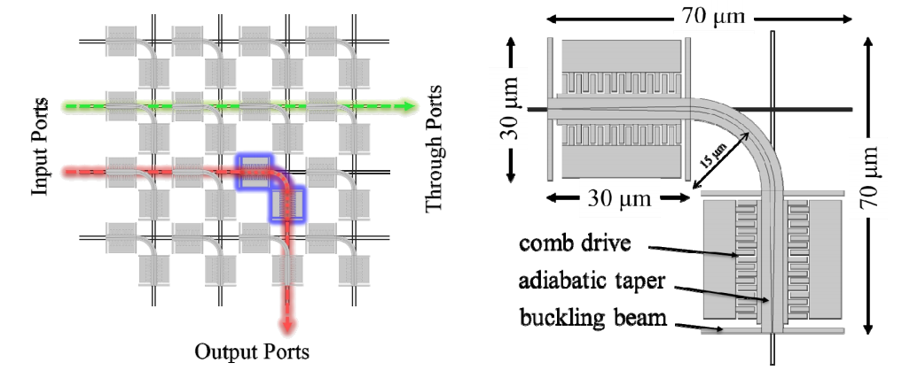
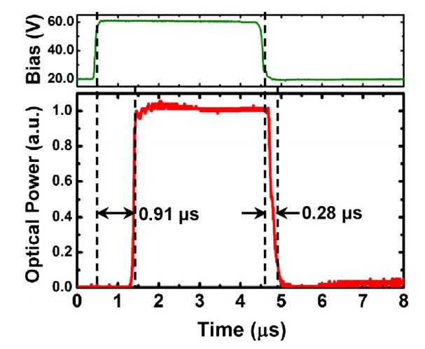
2.1 Original design & optimization
The matrix exists on 2 levels (top & bottom)
The original design exhibits bi-axial stress. Leads to instabilities, and torsion.
Footprint could be reduced and switching speed could be improved (currently : 1 us).
Any design must maintain the same optical losses.
Low-loss crossing is untouched.
5
Temporal response of unit cell

Slide 6
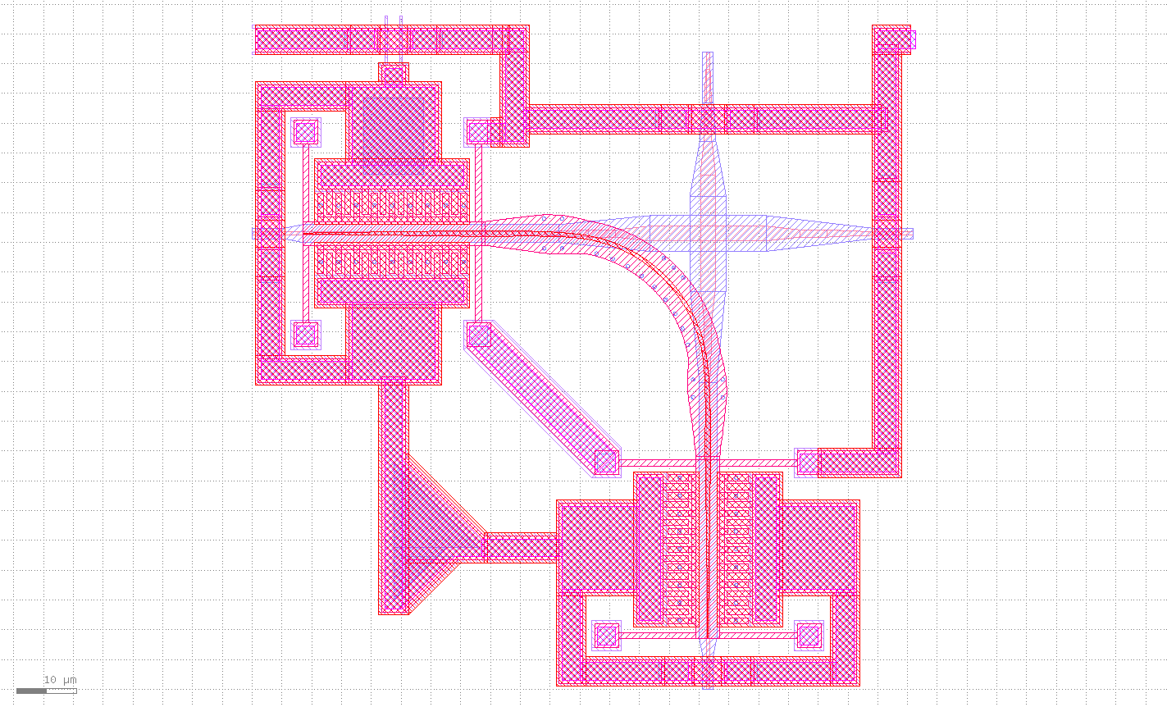
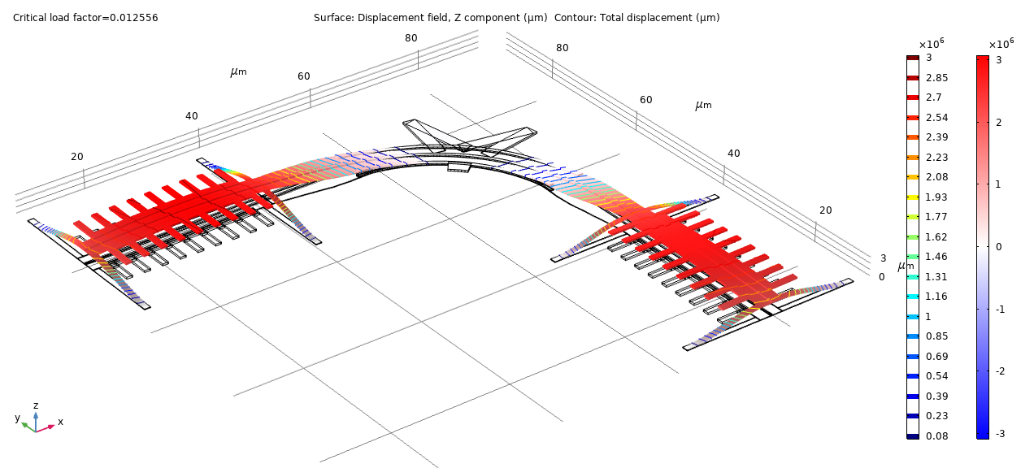
2.1 Original design & optimization (cont’d)
Optimization criteria :
Uniaxial stress only
Smaller footprint
Increase switching speed
Low losses
(optional) all inputs (resp. outputs) on the same side
6

Slide 7
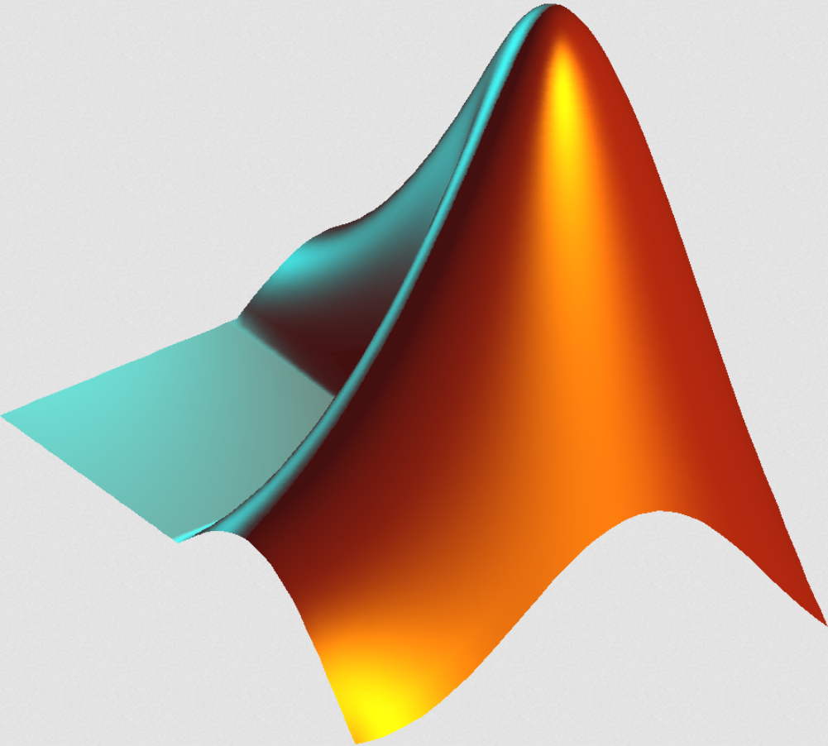



2.2 Methods and tools
Geometry design on paper.
Implementation of specific elements using MATLAB.
Verification using KLayout & L-Edit.
Assembly on L-Edit.
Simulation on COMSOL.
7

Slide 8
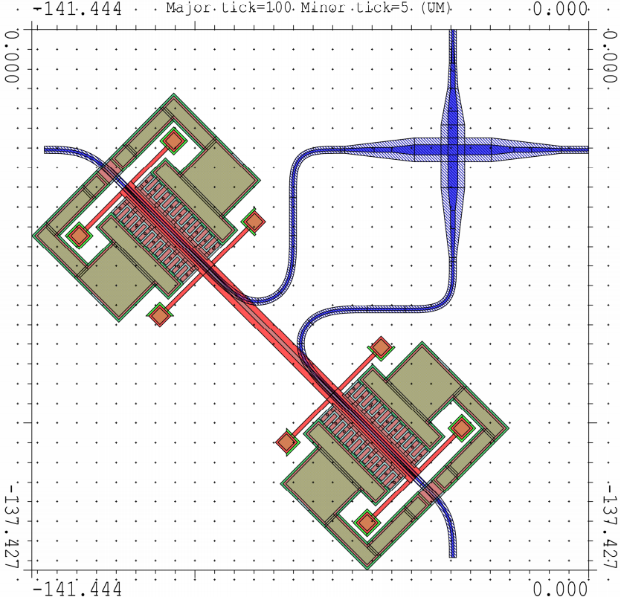
3.1 Design 1 : Linear Coupler
Coupler principle : linear clamped-clamped beam.
Bottom waveguide is deformed to comply with the geometry.
We use a Sine-Circle-Sine curve matching strategy.
Minimum radius of curvature is 5 um (strip). Curvature must be continuous.
Estimated loss : 0.036 dB
8

Slide 9
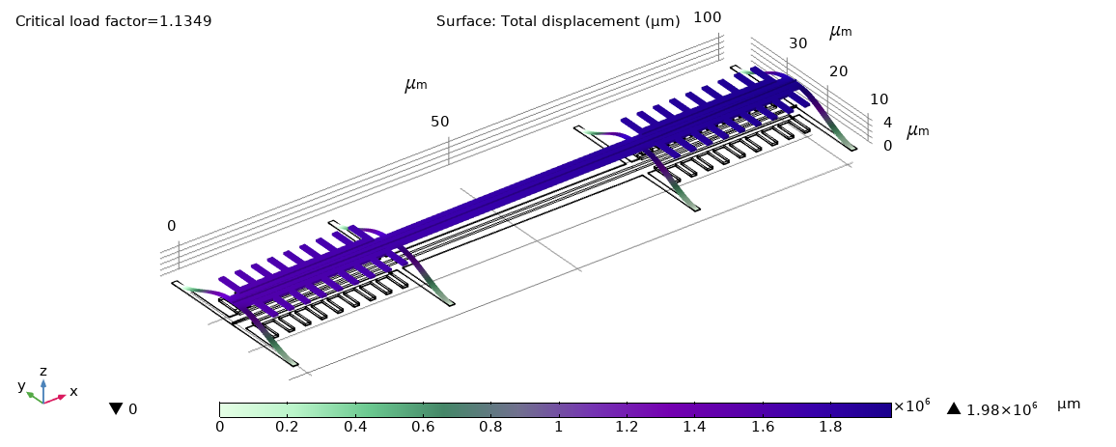
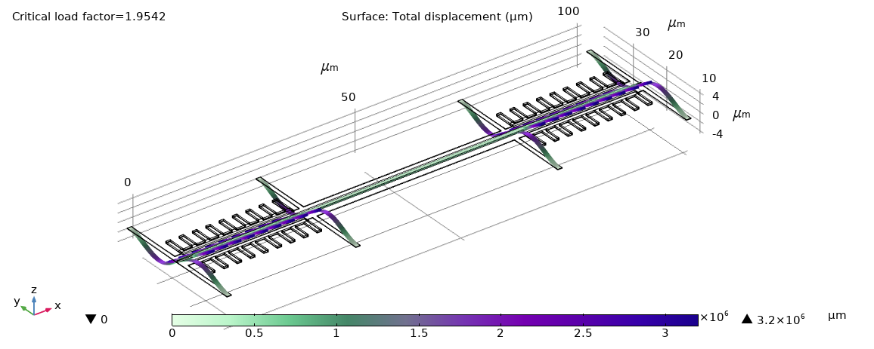
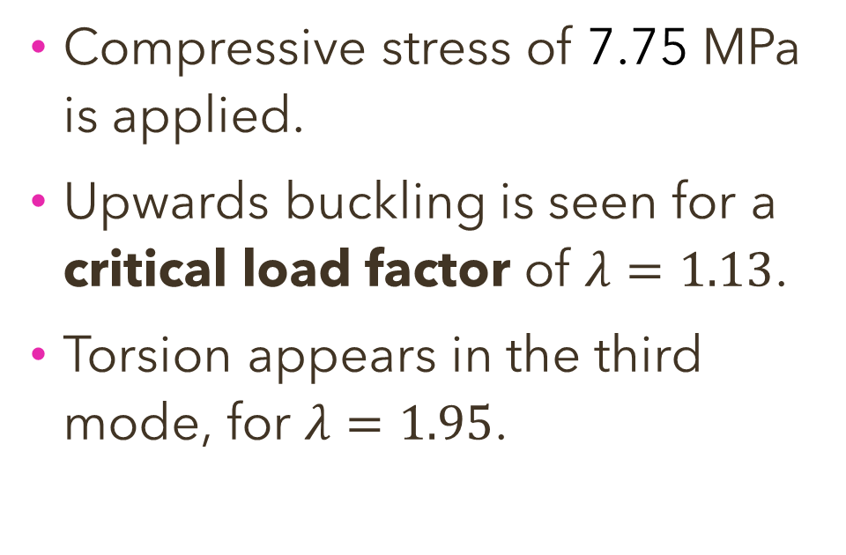
3.2 COMSOL simulations
Compressive stress of 7.75 MPa is applied.
Upwards buckling is seen for a critical load factor of $λ=1.13$.
Torsion appears in the third mode, for $λ=1.95$.
First mode, critical load factor = 1.13
Third mode, critical load factor = 1.95
9

Slide 10
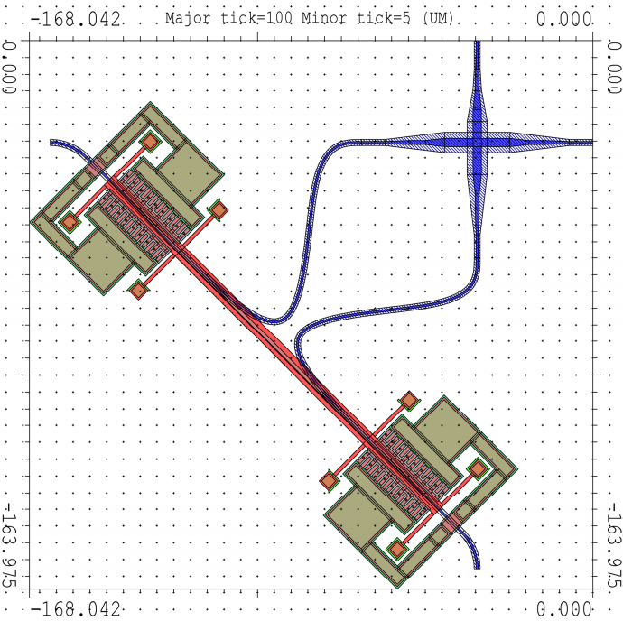
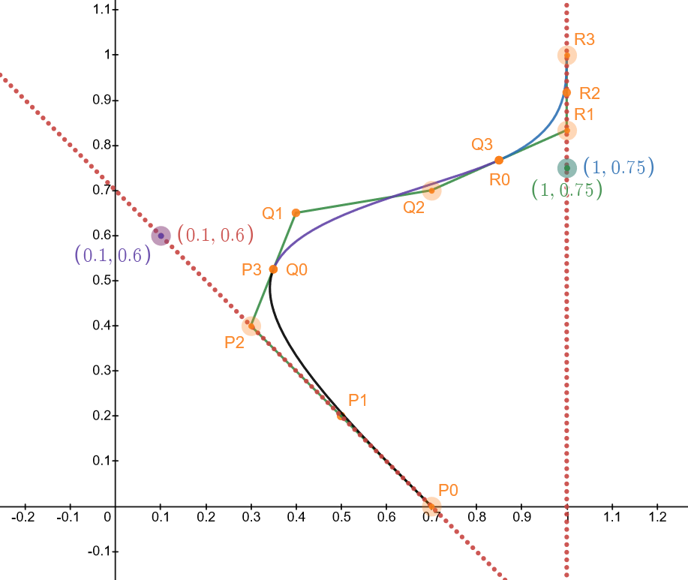
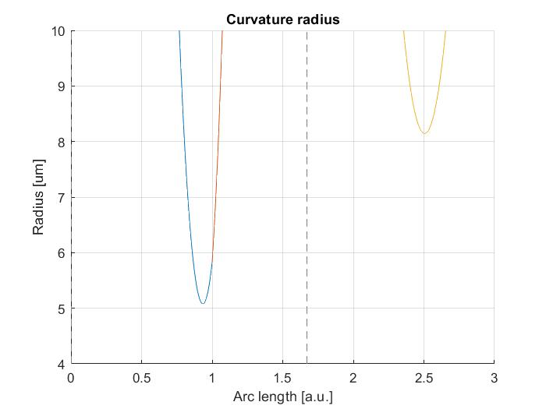
3.3 Other waveguide designs
Using 3rd order Bézier curve segments
The design respects all constraints.
However the entire path should be rib waveguides.
Coupler length is higher.
Estimated loss : 0.033 dB
10

Slide 11
3.4 Design 1 : Limitations
Main limiting parameter is the crossing of both ‘’lobes’’ on the bottom waveguide. Pushing the drive closer to the low-loss crossing creates an overlap in the lobes.
A more compact design also interferes with the suspension and the row/column addressing.
11

Slide 12
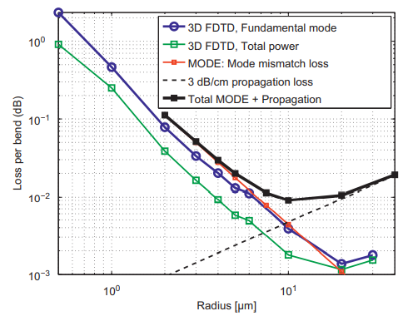
3.5 Design 1 - Conclusions
3rd order Bézier curves provide an elegant solution to the problem.
The need for fully etched strip waveguides over a long distance is problematic for losses.
Using sine-circle-sine constructions requires additional steps, but the tapering needed for the rib-strip adiabatic transition is possible.
Simulations show expected behavior.
12

Slide 13
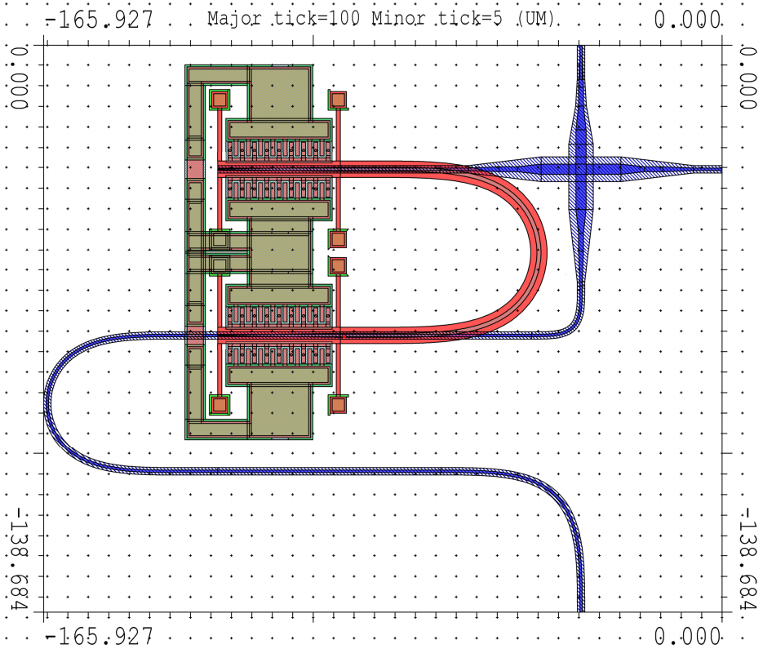
4.1 Design 2 : U-Turn coupler
Coupler principle : U-Turn with suspended coupler.
Bottom waveguide is deformed using sine-circle-sine methods.
Minimum radius of curvature is 5 um (strip).
Estimated loss : 0.038 dB
13

Slide 14
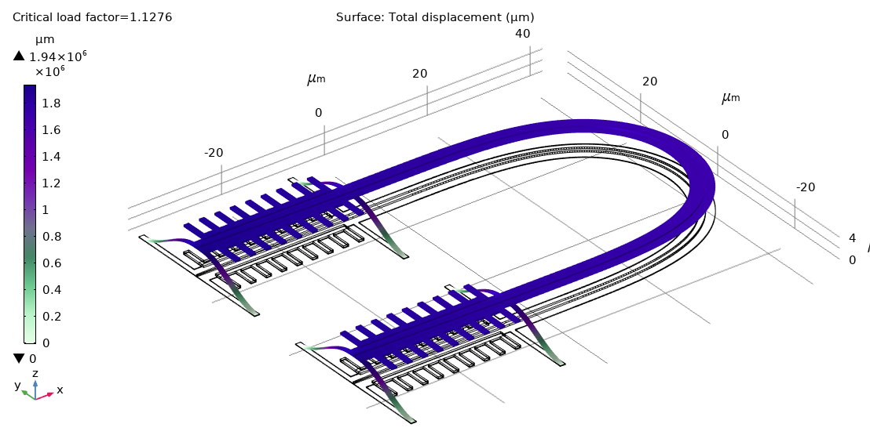
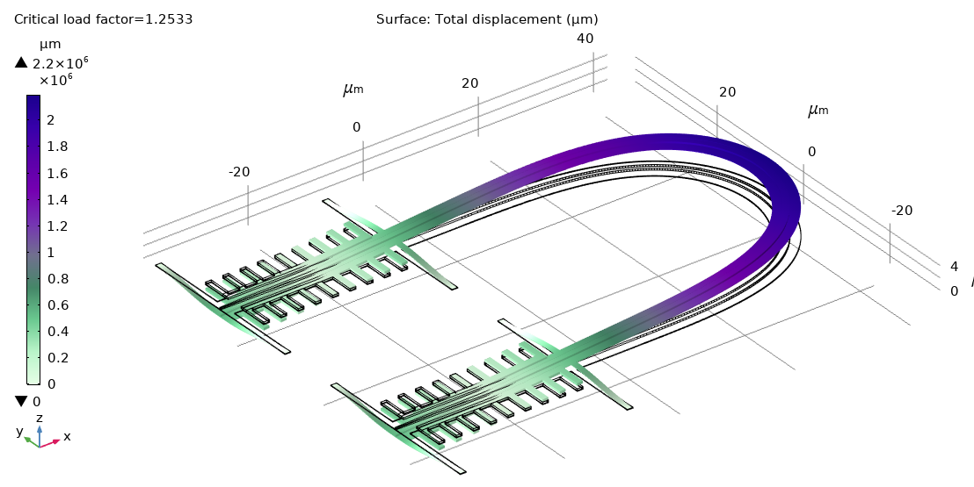
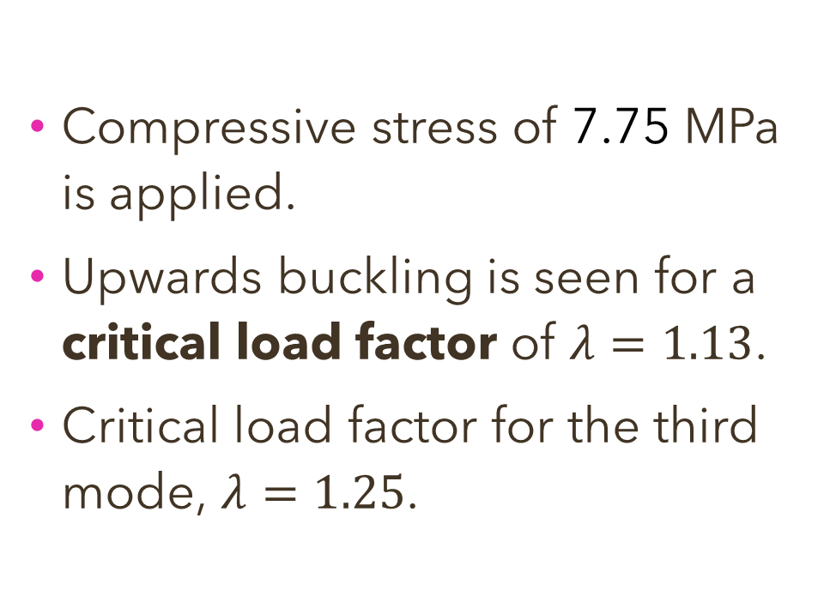
4.2 COMSOL simulations
Compressive stress of 7.75 MPa is applied.
Upwards buckling is seen for a critical load factor of $λ=1.13$.
Critical load factor for the third mode, $λ=1.25$.
First mode, critical load factor = 1.13
1
14
Third mode, critical load factor = 1.25

Slide 15
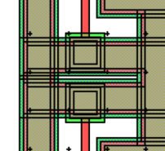
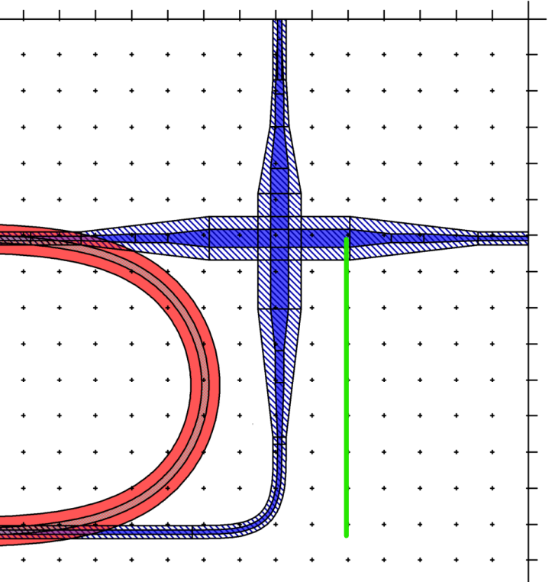
4.3 Limitations
Trying to push the comb drives together creates an overlap of the suspension elements, and limits the minimum radius of the coupler.
This can be improved by reducing the mode matching between adiabatic coupler and U-Turn.
The curve matching of the bottom waveguide creates a long optical path.
Limiting length
1
15

Slide 16
4.4 Design 2 - Conclusions
The geometry’s compactness is limited in part by the low loss crossing’s size (good).
A compact U-Turn requires a redesign of the comb drives.
The system could potentially be driven by the outer drives only, and joint in the middle.
Simulations show that the 3 first buckling modes are close to each other in critical load factor.
16

Slide 17
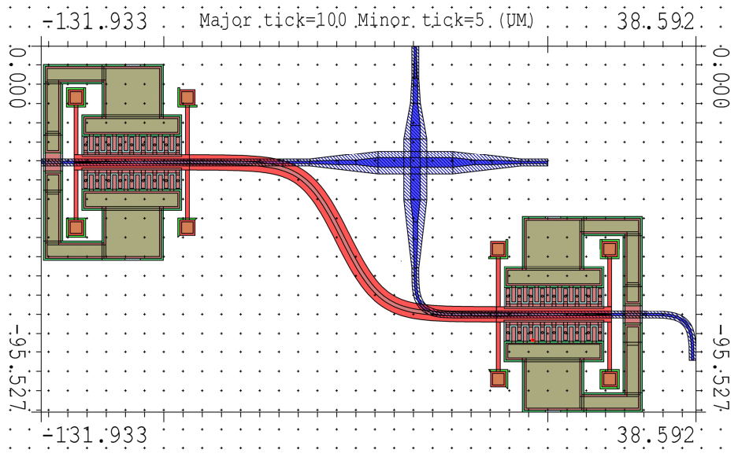
5. Other design idea : sigmoid
Uses a sigmoid logistic function to model the coupler : 0 curvature at ends.
Uniaxial stress, large curvature radii, compact, but long coupler length.
The coupler can be mechanically unstable !
17

Slide 18
6.1 Next steps
Design the row/column addressing (all).
Design the tapering on Si FTE layer for strip-rib adiabatic transition (all).
Re-design the comb drive and assembly (U-Turn).
Simulate buckling for completeness purposes (Sigmoid).
18

Slide 19
6.2 Conclusions
Linear coupler appears to be the easiest optimization solution.
The U-Turn coupler needs a redesign of the comb drives but could be more compact.
Comparable losses between all designs.
 | Pros | Cons
Linear coupler | Simple coupler design. Uses tested components. Small coupler. | Large footprint (unused space). Tight curves.
U-Turn coupler | Potentially compact. Limited by low-loss crossing. | Requires redesign of some elements.
Sigmoid coupler | Compact. Low curvature. All outputs on the same side. | Mechanically unstable. Large coupler length.
19

Slide 20
Thank you ! Questions ?
Presented by : Claudio Jaramillo, claudio.jaramilloconcha@epfl.ch
20

